Slide 1
Dyslexia
Parent Night 2021
Title of Presentation Subtitle Month 00, 2021

Slide 2
Norms:
1. Please make sure you microphone is muted
2. Camera on or off is your choice
3. Place all questions in the Microsoft Form
4. The Main Room will remain open if you need guidance

Slide 3
Dyslexia does not strip the person from feeling the joys of the written word. It simply puts you on a different path of learning that will help you discover your child's beautiful and creative mind.
Author Unknown

Slide 4
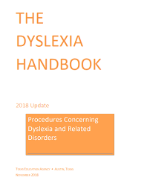
Dyslexia Handbook
1. Definitions and Characteristics of Dyslexia-Page 1
2. Screening-Timelines, Grades, and Data Collection-Page 7
3. Procedures for the Evaluation and Identification of Students with Dyslexia- Page 21
4. Critical, Evidence-Based Components of Dyslexia Instruction

Slide 5
Instruction
FBISD offers an Orton Gillingham program to all students (Monolingual and Bilingual) who are identified with Dyslexia or Related Disorder.
This is in accordance with 19 TAC §74.28(c), districts shall purchase or develop a reading program for students with dyslexia and related disorders that incorporates all the components of instruction and instructional approaches in the following sections:
Critical, Evidence-Based Components of Dyslexia Instruction
Delivery of Dyslexia Instruction

Slide 6
Accommodations:
*Accommodations are not one size fits all; rather, the impact of dyslexia on each individual student determines the accommodations necessary.
*Accommodations are changes to materials, actions, or techniques, including the use of technology, that enable students with disabilities to participate meaningfully in grade-level or course instruction.
An accommodation are data driven changes on HOW a student learns the material.

Slide 7
My child has been identified with dyslexia. What can I expect next?

Slide 8
Student Support Services Department

